Slide 1
MongoDB Data types

Slide 2
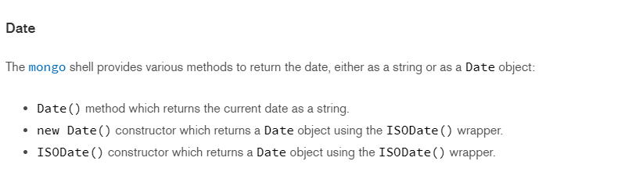
Date

Slide 3
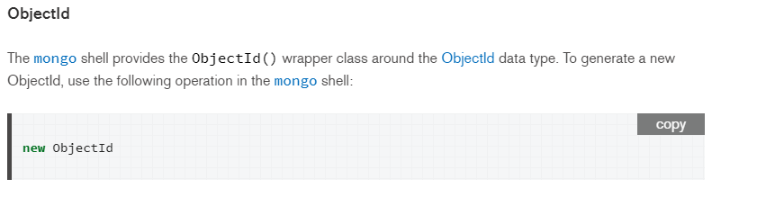
ObjectId

Slide 4
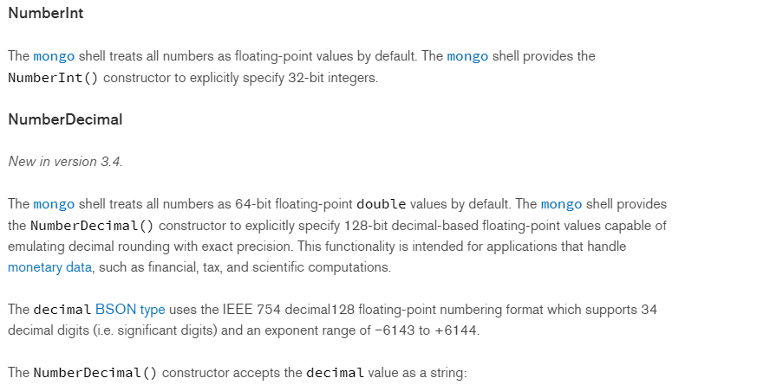
NumberInt & NumberDecimal

Slide 5
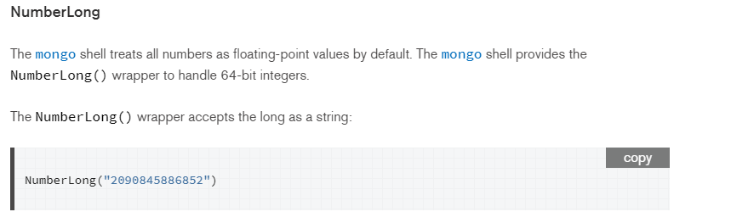
NumberLong

Slide 6
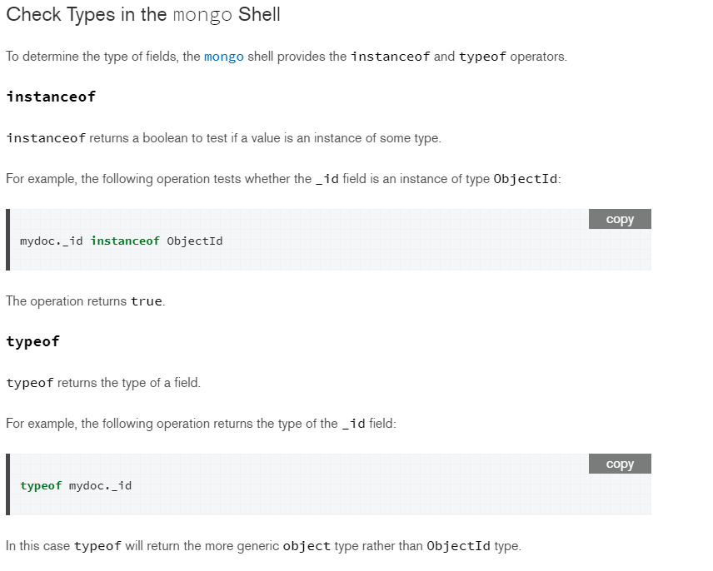
Instanceof & typeof

